Slide 1
HOLD BOOK GUIDE
Employee name: 許氏玲
Department: IT-SFIS-C03
Prepare date: 09-07-2021

Slide 2

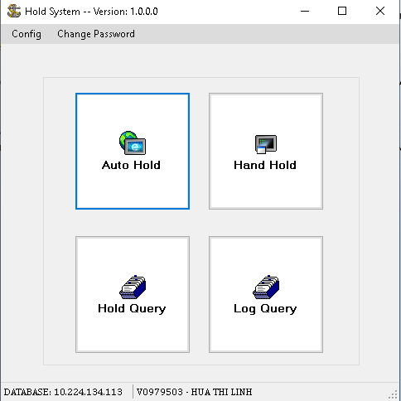
HOLD BOOK GUIDE
1.MAIN INTERFACE ITEM
1. Menu

Slide 3
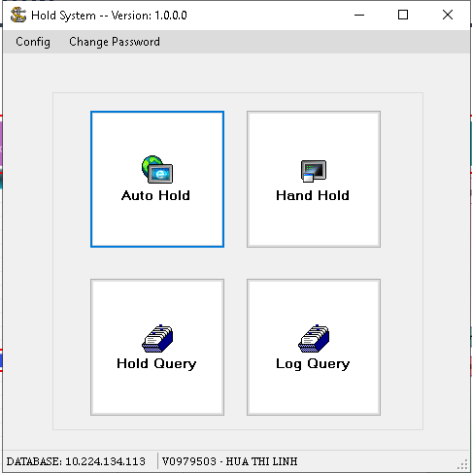
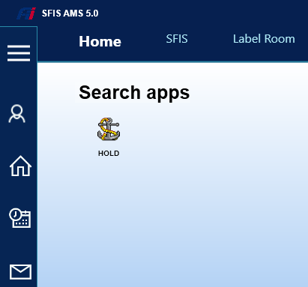
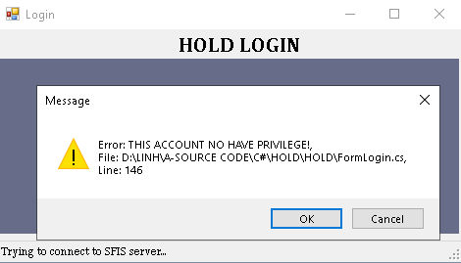
HOLD BOOK GUIDE
2.LOGIN
Login to SFIS_AMS then double click on HOLD program.
Login OK
Login NG
If account no have privilege, please contact with IT for permission.

Slide 4
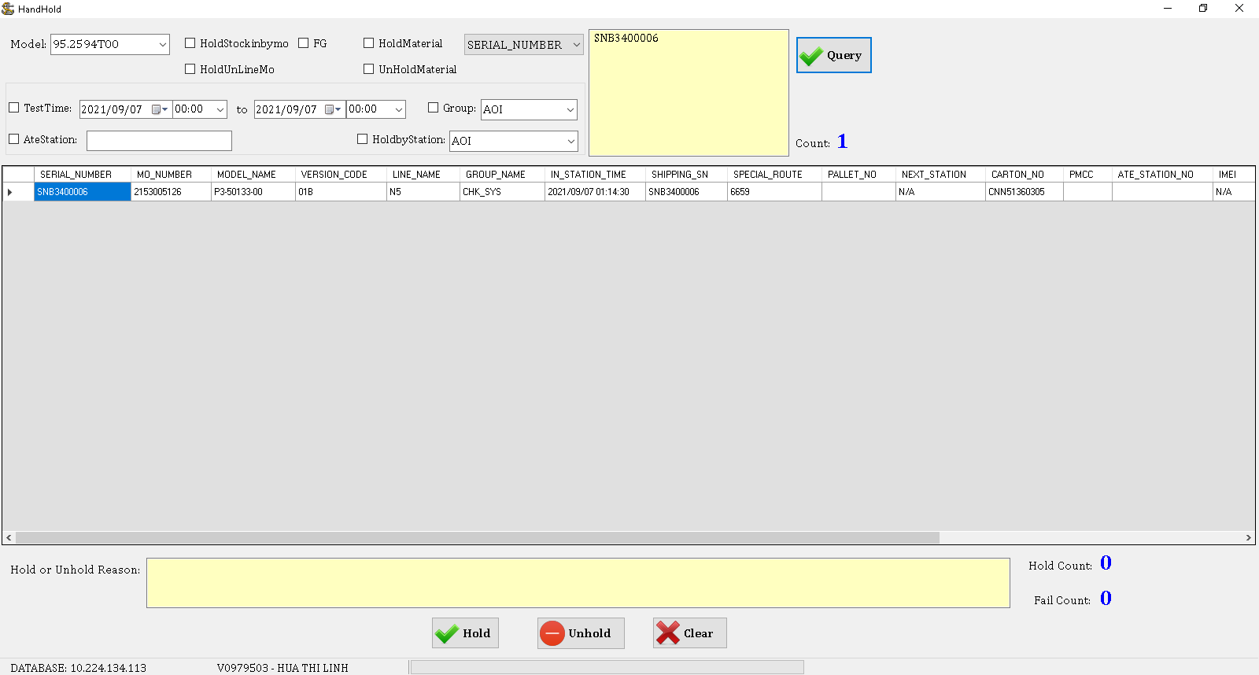
HOLD BOOK GUIDE
3.HAND HOLD
2
3
4
1
5
Hand Hold follow step bellow:
Choose Hand Hold
Choose type want to search
Input data want to search
Click Query
Input Hold or Unhold reason
Click Hold or Unhold
6

Slide 5
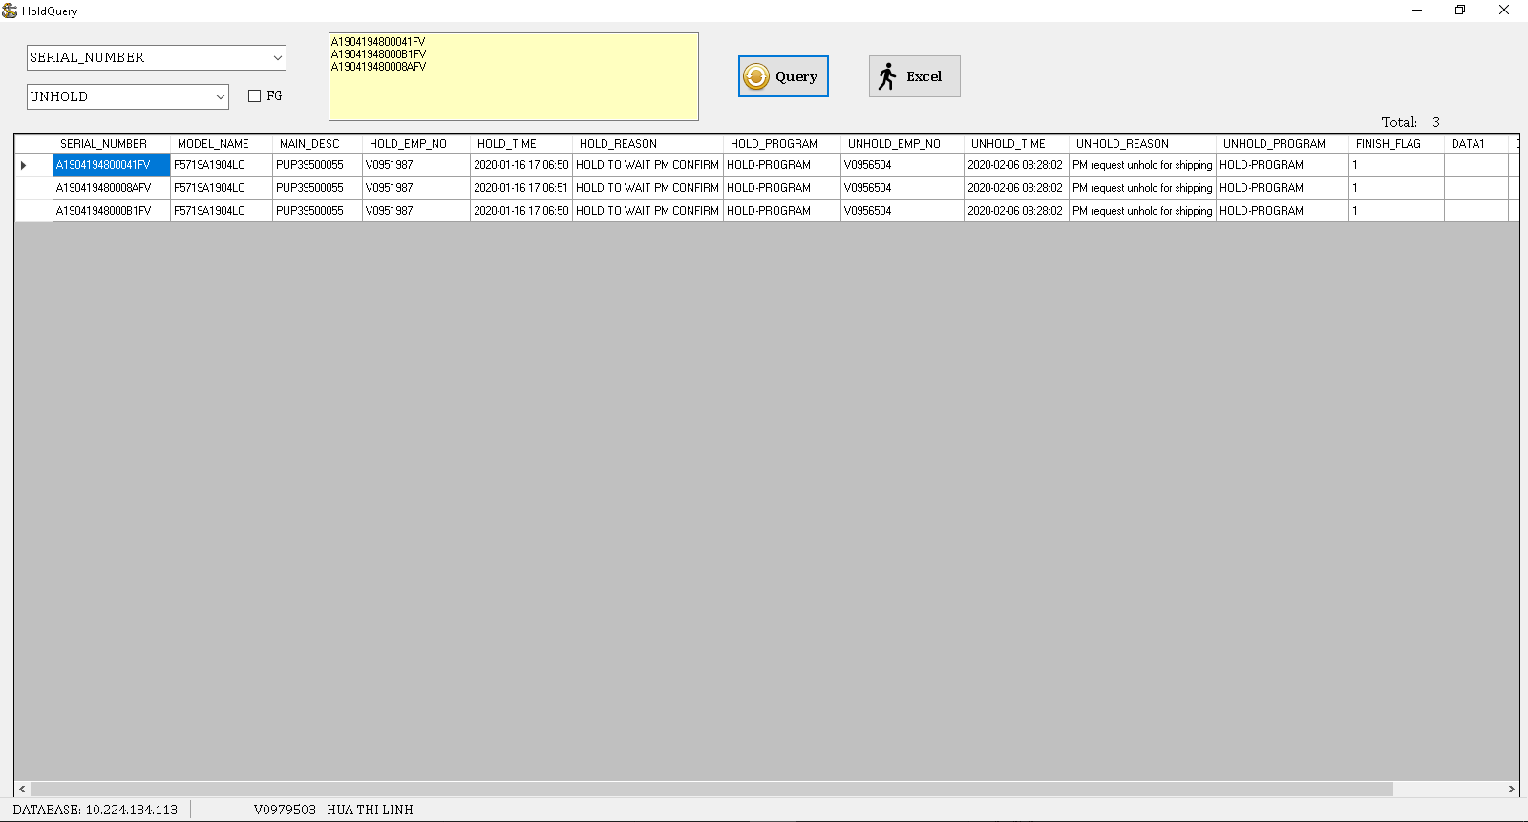
HOLD BOOK GUIDE
4.HOLD QUERY
2
3
4
5
1
Hold Query file follow step bellow:
Choose Log Query
Choose type want to search
Input data want to search
Click Query
Click Excel if want to export to excel file

Slide 6
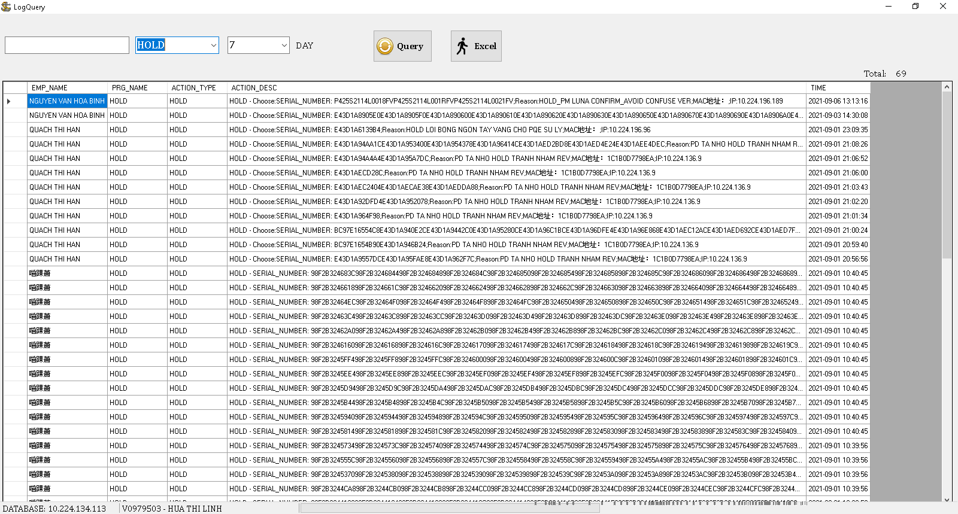
HOLD BOOK GUIDE
5.LOG QUERY
2
3
4
1
Log Query file follow step bellow:
Choose Log Query
Choose label file
Click Query
Click Excel if want export to excel file.

Slide 7
HOLD BOOK GUIDE
THANKS FOR WATCHING

